Slide 1
Sequence Assembly
Vijini Mallawaarachchi

Slide 2
Book Problem
Obtain the books
Shred the Books
Recover the book
Adapted from Dr Yu Lin’s slides

Slide 3
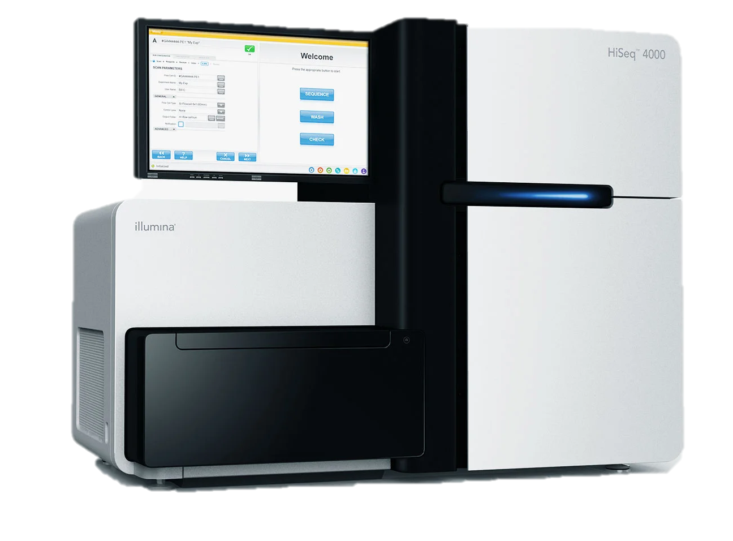
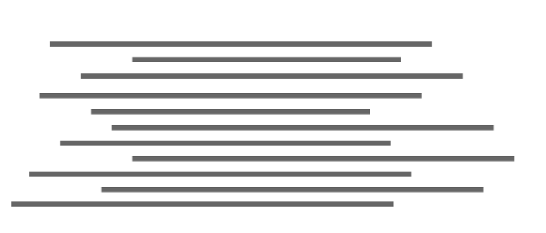
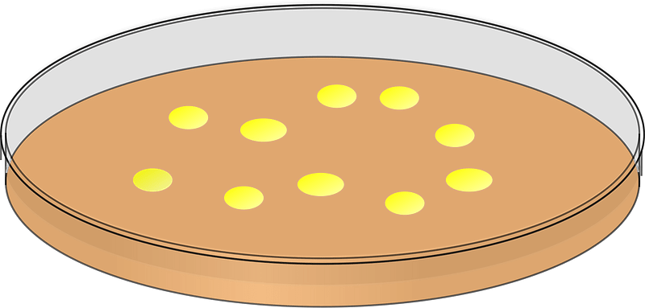
Genome Assembly
Sample
Sequence the Sample
Recover the Genome
Adapted from Dr Yu Lin’s slides

Slide 4
Library Problem
…
Obtain Books
Shred the Books
Recover the Books
Adapted from Dr Yu Lin’s slides

Slide 5
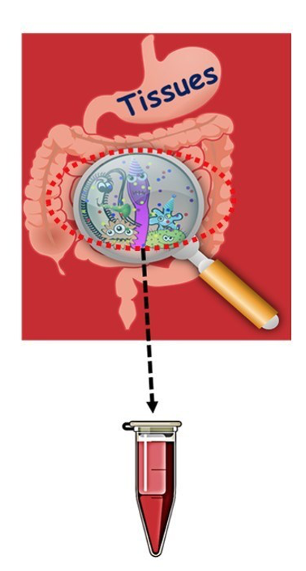
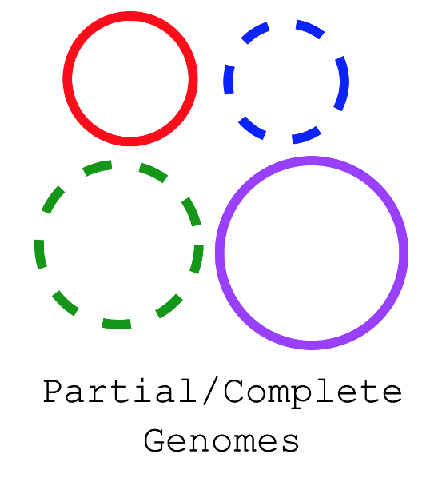
Metagenome Assembly
Environmental Sample
Sequence the Sample
Recover the Genomes
Adapted from Dr Yu Lin’s slides

Slide 6
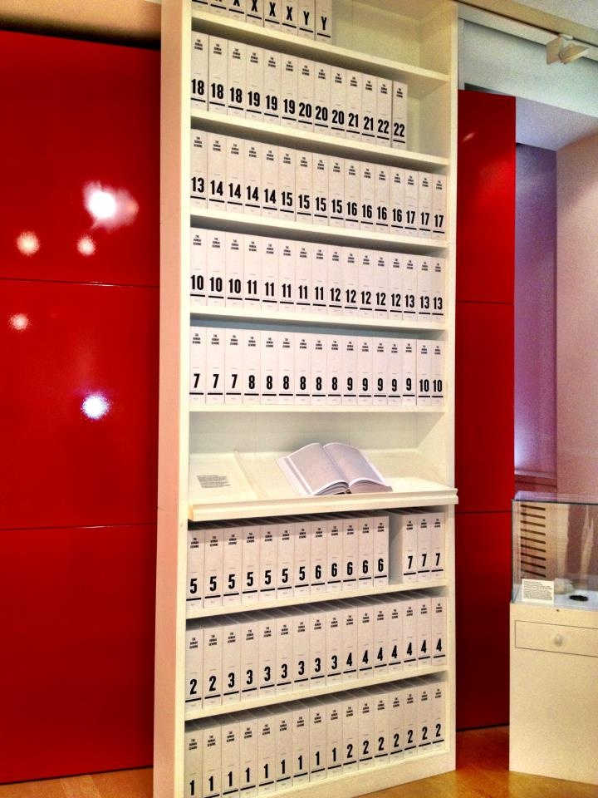
Why we need Assembly?
Problem: the longest single sequence possible is 1,000 bp, and most technology is 50-500 bp.
Long read technologies are still not enough.
Human genome is 3,000,000,000 bp.
Microbial genomes are 2,000,000 bp.
Therefore how do you sequence a whole genome?
Image Source: Pinterest
Adapted from Prof Rob Edward’s slides
Notes:
Image of printed copy of the human genome → They say it has taken 130 book volumes, which would take 95 years to read

Slide 7
Multiple Copies of a Genome
CTGATGATGGACTACGCTACTACTGCTAGCTGTATTACGATCAGCTACCACATCGTAGCTACGATGCATTAGCAAGCTATCGGATCAGCTACCACATCGTAGC
Make copies
CTGATGATGGACTACGCTACTACTGCTAGCTGTATTACGATCAGCTACCACATCGTAGCTACGATGCATTAGCAAGCTATCGGATCAGCTACCACATCGTAGC
CTGATGATGGACTACGCTACTACTGCTAGCTGTATTACGATCAGCTACCACATCGTAGCTACGATGCATTAGCAAGCTATCGGATCAGCTACCACATCGTAGC
CTGATGATGGACTACGCTACTACTGCTAGCTGTATTACGATCAGCTACCACATCGTAGCTACGATGCATTAGCAAGCTATCGGATCAGCTACCACATCGTAGC
CTGATGATGGACTACGCTACTACTGCTAGCTGTATTACGATCAGCTACCACATCGTAGCTACGATGCATTAGCAAGCTATCGGATCAGCTACCACATCGTAGC
Adapted from Dr Yu Lin’s slides

Slide 8
Breaking the Genomes at Random Positions
CTGATGATGGACTACGCTACTACTGCTAGCTGTATTACGATCAGCTACCACATCGTAGCTACGATGCATTAGCAAGCTATCGGATCAGCTACCACATCGTAGC
CTGATGATGGACTACGCTACTACTGCTAGCTGTATTACGATCAGCTACCACATCGTAGCTACGATGCATTAGCAAGCTATCGGATCAGCTACCACATCGTAGC
CTGATGATGGACTACGCTACTACTGCTAGCTGTATTACGATCAGCTACCACATCGTAGCTACGATGCATTAGCAAGCTATCGGATCAGCTACCACATCGTAGC
CTGATGATGGACTACGCTACTACTGCTAGCTGTATTACGATCAGCTACCACATCGTAGCTACGATGCATTAGCAAGCTATCGGATCAGCTACCACATCGTAGC
Adapted from Dr Yu Lin’s slides

Slide 9
Generating “Reads”
CTGATGA TGGACTACGCTAC TACTGCTAG CTGTATTACG ATCAGCTACCACA TCGTAGCTACG ATGCATTAGCAA GCTATCGGA TCAGCTACCA CATCGTAGC
CTGATGATG GACTACGCT ACTACTGCTA GCTGTATTACG ATCAGCTACC ACATCGTAGCT ACGATGCATTA GCAAGCTATC GGATCAGCTAC CACATCGTAGC
CTGATGATGG ACTACGCTAC TACTGCTAGCT GTATTACGATC AGCTACCAC ATCGTAGCTACG ATGCATTAGCA AGCTATCGG A TCAGCTACCA CATCGTAGC
CTGATGATGGACT ACGCTACTACT GCTAGCTGTAT TACGATCAGC TACCACATCGT AGCTACGATGCA TTAGCAAGCT ATCGGATCA GCTACCACATC GTAGC
Adapted from Dr Yu Lin’s slides

Slide 10
No Idea What Position Reads Comes From
ATCAGCTACCA
CTGATGATGGACT
AGCTATCGG
ATGCATTAGCA
TGGACTACGCTAC
AGCTACGATGCA
TACTGCTAG
ATCAGCTACC
TCGTAGCTACG
CATCGTAGC
TTAGCAAGCT
CTGATGA
GCTGTATTACG
CTGATGATGG
TACTGCTAGCT
TCAGCTACCA
ATGCATTAGCA
CTGTATTACG
GCTACCACATC
GCTATCGGA
GCAAGCTATC
ATGCATTAGCAA
CTGATGATG
GACTACGCT
CATCGTAGC
ATCAGCTACCACA
ACGATGCATTA
CACATCGTAGC
ACGCTACTACT
ATCGGATCA
ACTACTGCTA
TACGATCAGC
TACCACATCGT
ACATCGTAGCT
CTGATGATGG
GGATCAGCTAC
GCAAGCTATC
AGCTACCAC
ACTACGCTAC
ATCGTAGCTACG
ATCGTAGCTACG
TACTGCTAGCT
GCTAGCTGTAT
GTATTACGATC
Adapted from Dr Yu Lin’s slides

Slide 11
No Idea What Position Reads Comes From
ATCAGCTACCA
CTGATGATGGACT
AGCTATCGG
ATGCATTAGCA
TGGACTACGCTAC
AGCTACGATGCA
TACTGCTAG
ATCAGCTACC
TCGTAGCTACG
CATCGTAGC
TTAGCAAGCT
CTGATGA
GCTGTATTACG
CTGATGATGG
TACTGCTAGCT
GCTATCGGA
TCAGCTACCA
ATGCATTAGCA
CTGTATTACG
GCTACCACATC
GCAAGCTATC
ATGCATTAGCAA
CTGATGATG
CATCGTAGC
ATCAGCTACCACA
GACTACGCT
ACGATGCATTA
CACATCGTAGC
ACGCTACTACT
ATCGGATCA
ACTACTGCTA
TACGATCAGC
TACCACATCGT
ACATCGTAGCT
CTGATGATGG
GGATCAGCTAC
GCAAGCTATC
AGCTACCAC
ACTACGCTAC
ATCGTAGCTACG
ATCGTAGCTACG
TACTGCTAGCT
GCTAGCTGTAT
GTATTACGATC
Adapted from Dr Yu Lin’s slides

Slide 12
But we can find Overlaps
ATCAGCTACCA
CTGATGATGGACT
AGCTATCGG
ATGCATTAGCA
TGGACTACGCTAC
AGCTACGATGCA
TACTGCTAG
ATCAGCTACC
TCGTAGCTACG
CATCGTAGC
TTAGCAAGCT
CTGATGA
GCTGTATTACG
CTGATGATGG
TACTGCTAGCT
GCTATCGGA
TCAGCTACCA
ATGCATTAGCA
CTGTATTACG
GCTACCACATC
GCAAGCTATC
ATGCATTAGCAA
CTGATGATG
CATCGTAGC
ATCAGCTACCACA
GACTACGCT
ACGATGCATTA
CACATCGTAGC
ACGCTACTACT
ATCGGATCA
ACTACTGCTA
TACGATCAGC
TACCACATCGT
ACATCGTAGCT
CTGATGATGG
GGATCAGCTAC
GCAAGCTATC
AGCTACCAC
ACTACGCTAC
ATCGTAGCTACG
ATCGTAGCTACG
TACTGCTAGCT
GCTAGCTGTAT
GTATTACGATC
Adapted from Dr Yu Lin’s slides

Slide 13
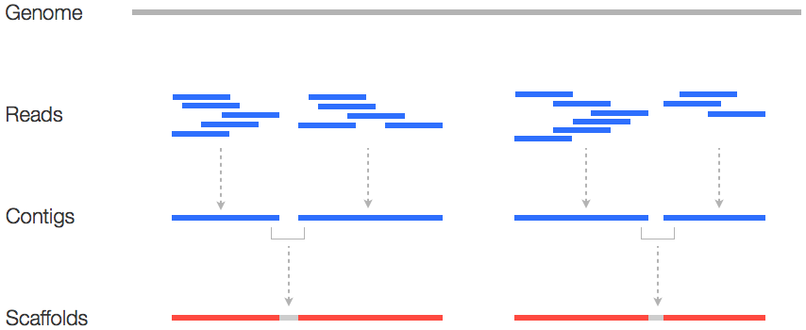
Sequence Assembly
The assembly groups
reads into contigs
contigs into scaffolds
Contigs provide
alignment of reads
consensus sequence
Scaffolds provide
contig order and orientation
sizes of the gaps between contigs
Image Source: https://www.researchgate.net/topic/Contig-Mapping
Notes:
Scaffolds are created by chaining contigs together using additional information about the relative position and orientation of the contigs in the genome

Slide 14
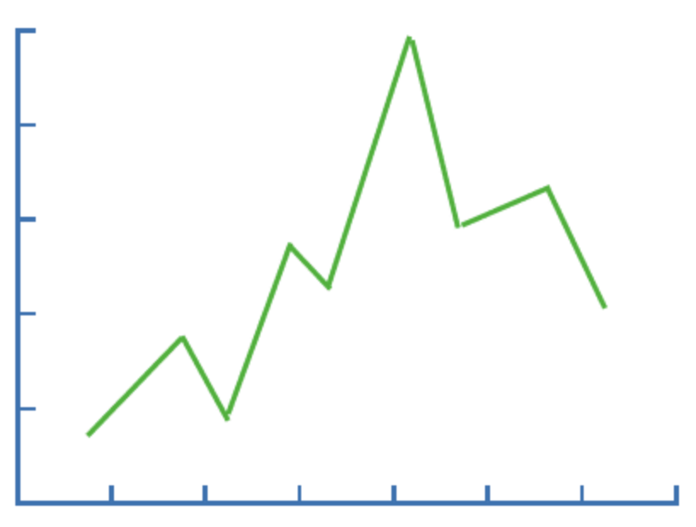
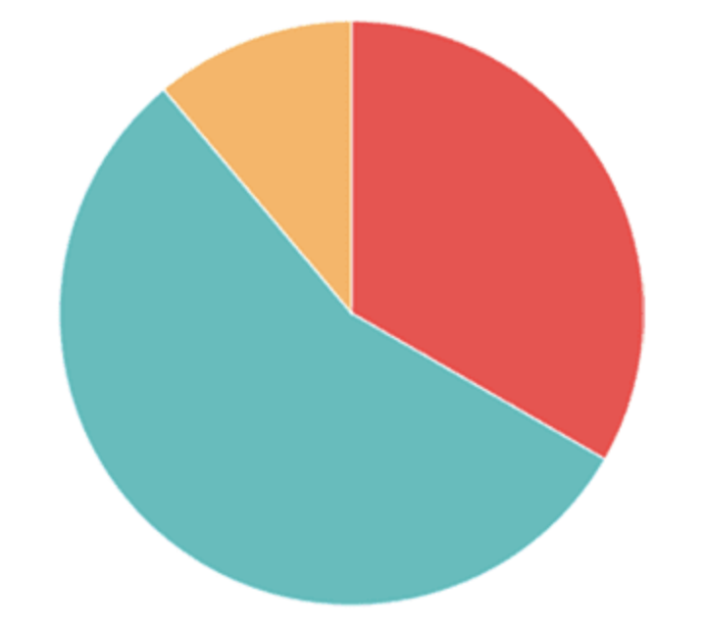
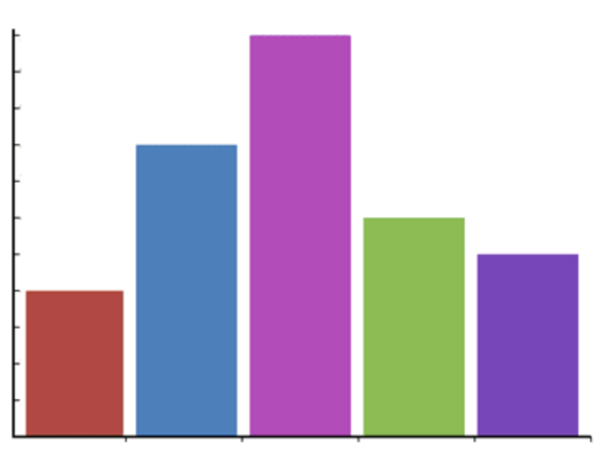
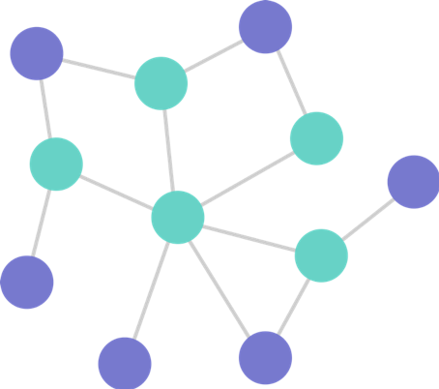
Can you identify which of these are graphs?
A. B. C. D.
Adapted from: https://www.slideshare.net/JosHctorGlvez/basics-of-genome-assembly

Slide 15
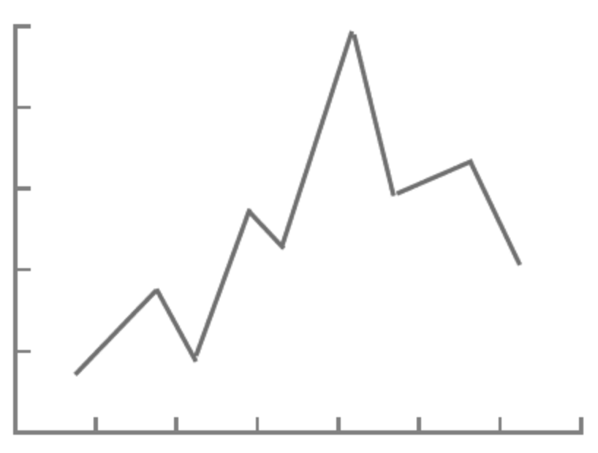
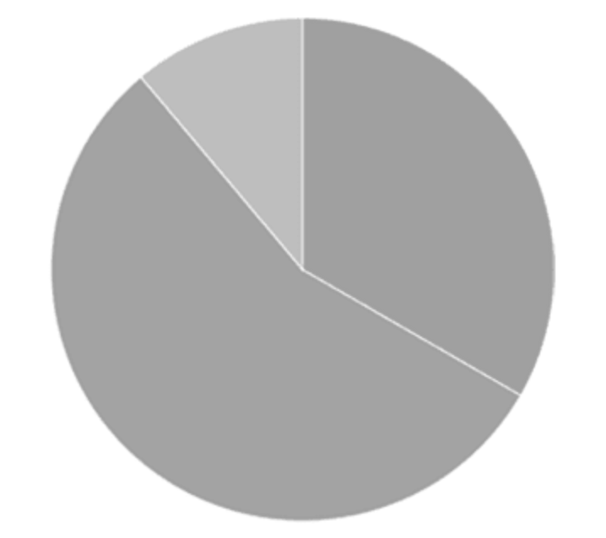
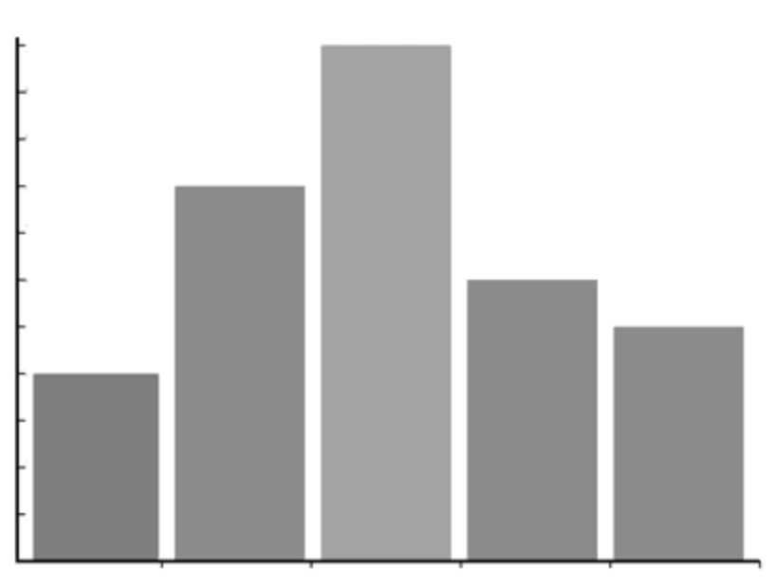
Can you identify which of these are graphs?
Vertices (Nodes)
Edges (Links)
In mathematics, a graph is a term that refers to a collections of vertices connected by edges.
Adapted from: https://www.slideshare.net/JosHctorGlvez/basics-of-genome-assembly

Slide 16
Assembly as a “Graph” Problem
A graph is vertices + edges
Consider direction of edges → edges have a start and end
Main structure used by assemblers
Vertices
(Nodes)
Edges
(Links)
Adapted from Prof Rob Edward’s slides

Slide 17
Main Approaches of Assembly
There are two approaches for de novo assembly
Overlap / Layout / Consensus (OLC)
de Bruijn Graphs (DBG)
Reference-guided assembly
Uses a reference genome to assist in assembly
Need to be sufficiently closely related

Slide 18
Overlap / Layout / Consensus
Overlap - Build overlap graph using reads
Layout - Bundle stretches of the overlap graph and layout the reads
Consensus - Pick the most likely nucleotide sequence for each position and build consensus contig
Read 1
Read 2
Read 3
Read 1
Read 2
Read 3
CGATTCTA
TTCTAAGT
GATTGTAA
CGATTCTAAGT
Adapted from: https://www.cs.jhu.edu/~langmea/resources/lecture_notes/assembly_olc.pdf

Slide 19
Problems with OLC
All versus all comparison of reads
We have millions or billions of reads from short-read sequencing data
Building overlap graph is slow

Slide 20
de Bruijn Graph
Similar to OLC, but graph is slightly different
Has some potentially helpful properties
Breaks reads into “k-mers”

Slide 21
What is a “k-mer”?
TAA
AAT
ATG
TGC
GCC
CCA
CAT
ATG
TGG
GGG
GGA
GAT
ATG
“k-mer” is a substring of length k
4 bases: {A, C, G, T}
4^{k} possible k-mers
3 bp: 4³ = 64
8 bp: 4⁸ = 65,336
20 bp: 4²⁰ = 1,099,511,627,776
I’ll use “k-1-mer” to refer to a substring of length k - 1
3-mer composition(TAATGCCATGGGATG)=
Adapted from Prof Rob Edward’s slides

Slide 22
de Bruijn Graph
We have 3 reads
R1: ACGC R2: CGCG R3: CGCT

Slide 23
de Bruijn Graph
We have 3 reads
R1: ACGC R2: CGCG R3: CGCT
Let’s obtain the 3-mers of these reads
R1: ACGC R2: CGCG R3: CGCT
ACG CGC CGC
CGC GCG GCT

Slide 24
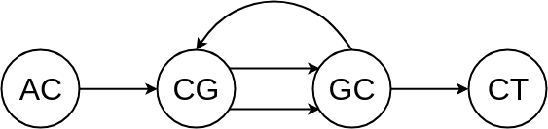
de Bruijn Graph
R1: ACGC R2: CGCG R3: CGCT
ACG CGC CGC
CGC GCG GCT
Build the de Bruijn graph
Vertices: k-1-mers
Edges: k-mers
GCG
ACG
CGC
GCT
CGC

Slide 25
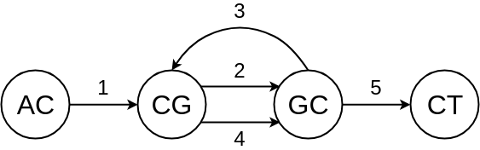
de Bruijn Graph
Build the de Bruijn graph
Vertices: k-1-mers
Edges: k-mers
Resolve the graph and get the genomic path
AC - CG - GC - CG - GC - CT
AC - CG - GC - CG - GC - CT
ACGCGCT

Slide 26
Advantages of DBG
DBG is faster than OLC
Fast graph construction using k-mers

Slide 27
OLC vs. DBG Trade-off
Assembly method | OLC | DBG
Speed | Slow | Fast
Graph nodes | Reads | k-1-mers
Graph edges | Overlaps | k-mers
Read contiguity | Preserved | Not preserved

Slide 28
Problems with all Assemblies
Sequencing errors
Ploidy???
CGATTCTAAGTAGCTTGCATA…
CGATTCTA
GCTTGCAT
TTCTAAGT
CTTCCATA
GATTGTAA
AGCTTGCA
TGTAAGTA
CTTGCAT
ATTCTAA
GTAAGTAG

Slide 29
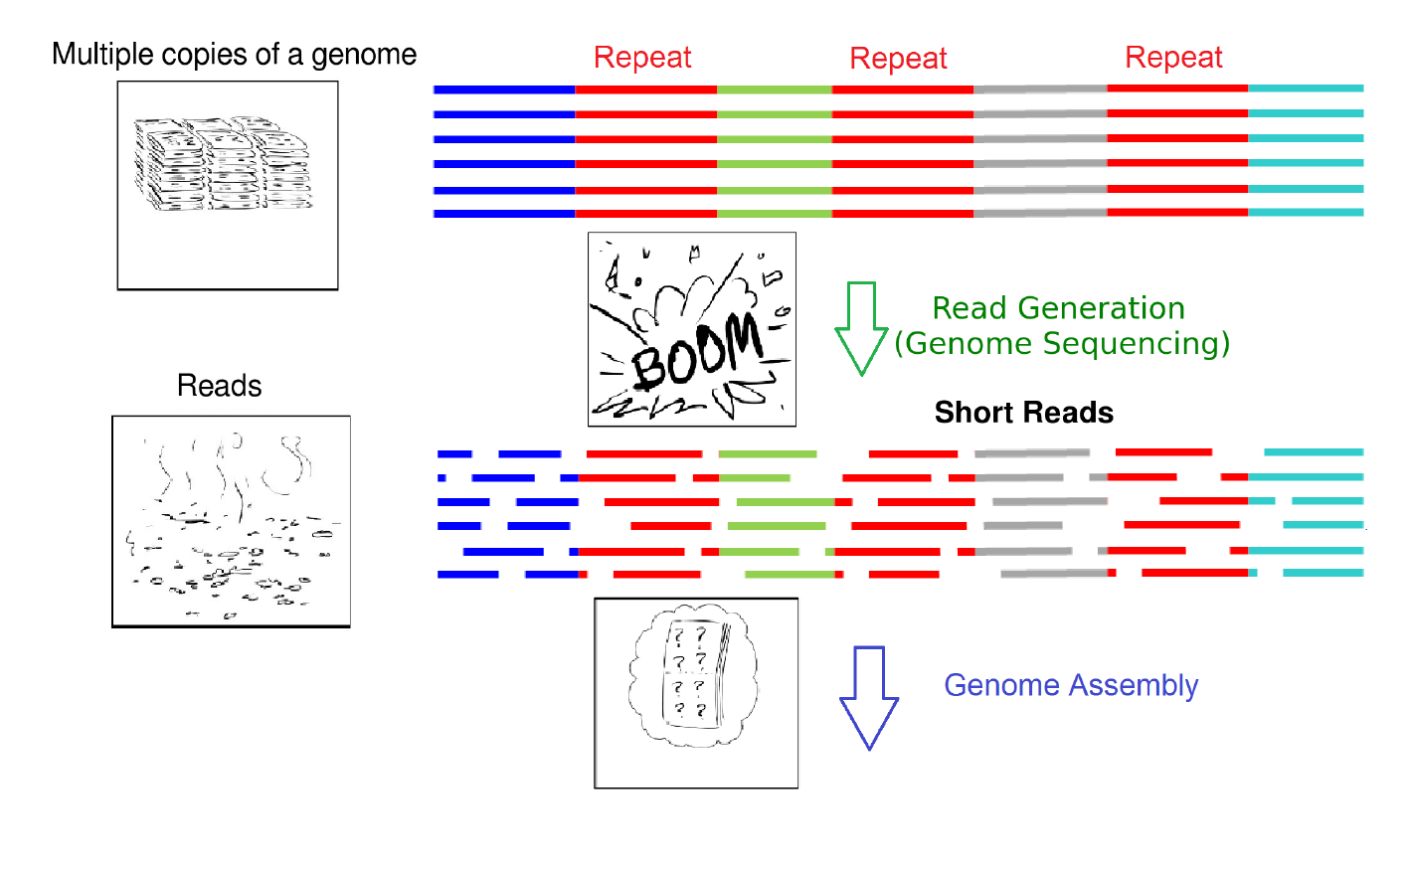
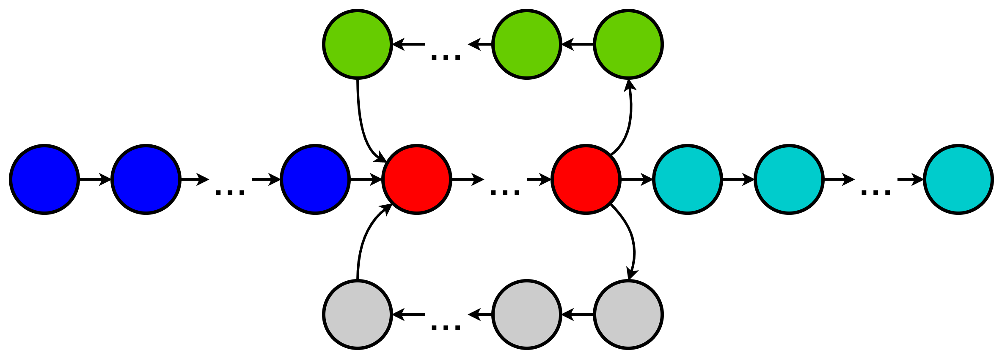
Problems with all Assemblies
Repeat Repeat Repeat
Multiple copies
of a genome
Read Generation
(Sequencing)
Short
Reads
Assembly
Final assembly

Slide 30
Problems with all Assemblies
Reads spanning across repeat regions
Repeat Repeat Repeat

Slide 31
Problems with all Assemblies
Reads spanning across repeat regions
Repeat Repeat Repeat
Repeat Repeat Repeat
Paired end reads

Slide 32
State-of-the-art Assemblers
Short-read assemblers
MEGAHIT (https://github.com/voutcn/megahit)
SPAdes → metaSPAdes (https://cab.spbu.ru/software/spades/)
Long-read assemblers
Canu (https://github.com/marbl/canu)
Flye → metaFlye (https://github.com/fenderglass/Flye)

Slide 33
metaSPAdes
Combining reads from samples
cat *_good_R1.fastq.gz > forward_reads.fastq.gz
cat *_good_R2.fastq.gz > reverse_reads.fastq.gz
Run metaSPAdes
spades.py -1 forward_reads.fastq -2 reverse_reads.fastq --meta -t 8 -o assembly_out

Slide 34
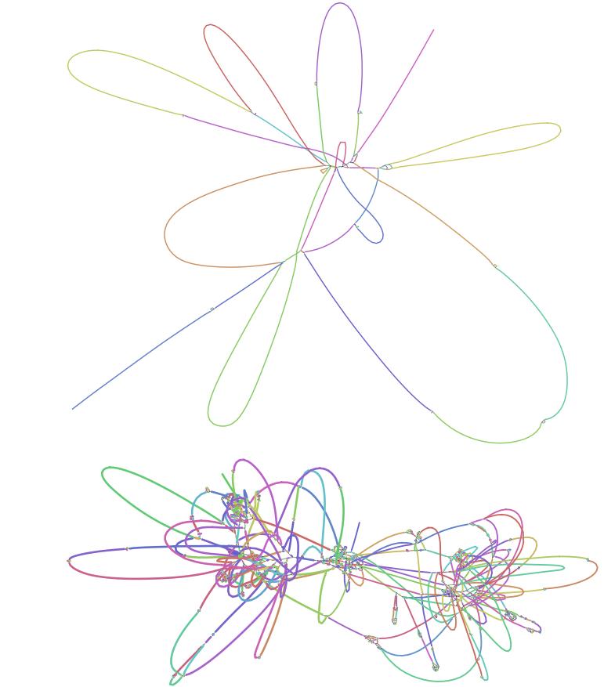
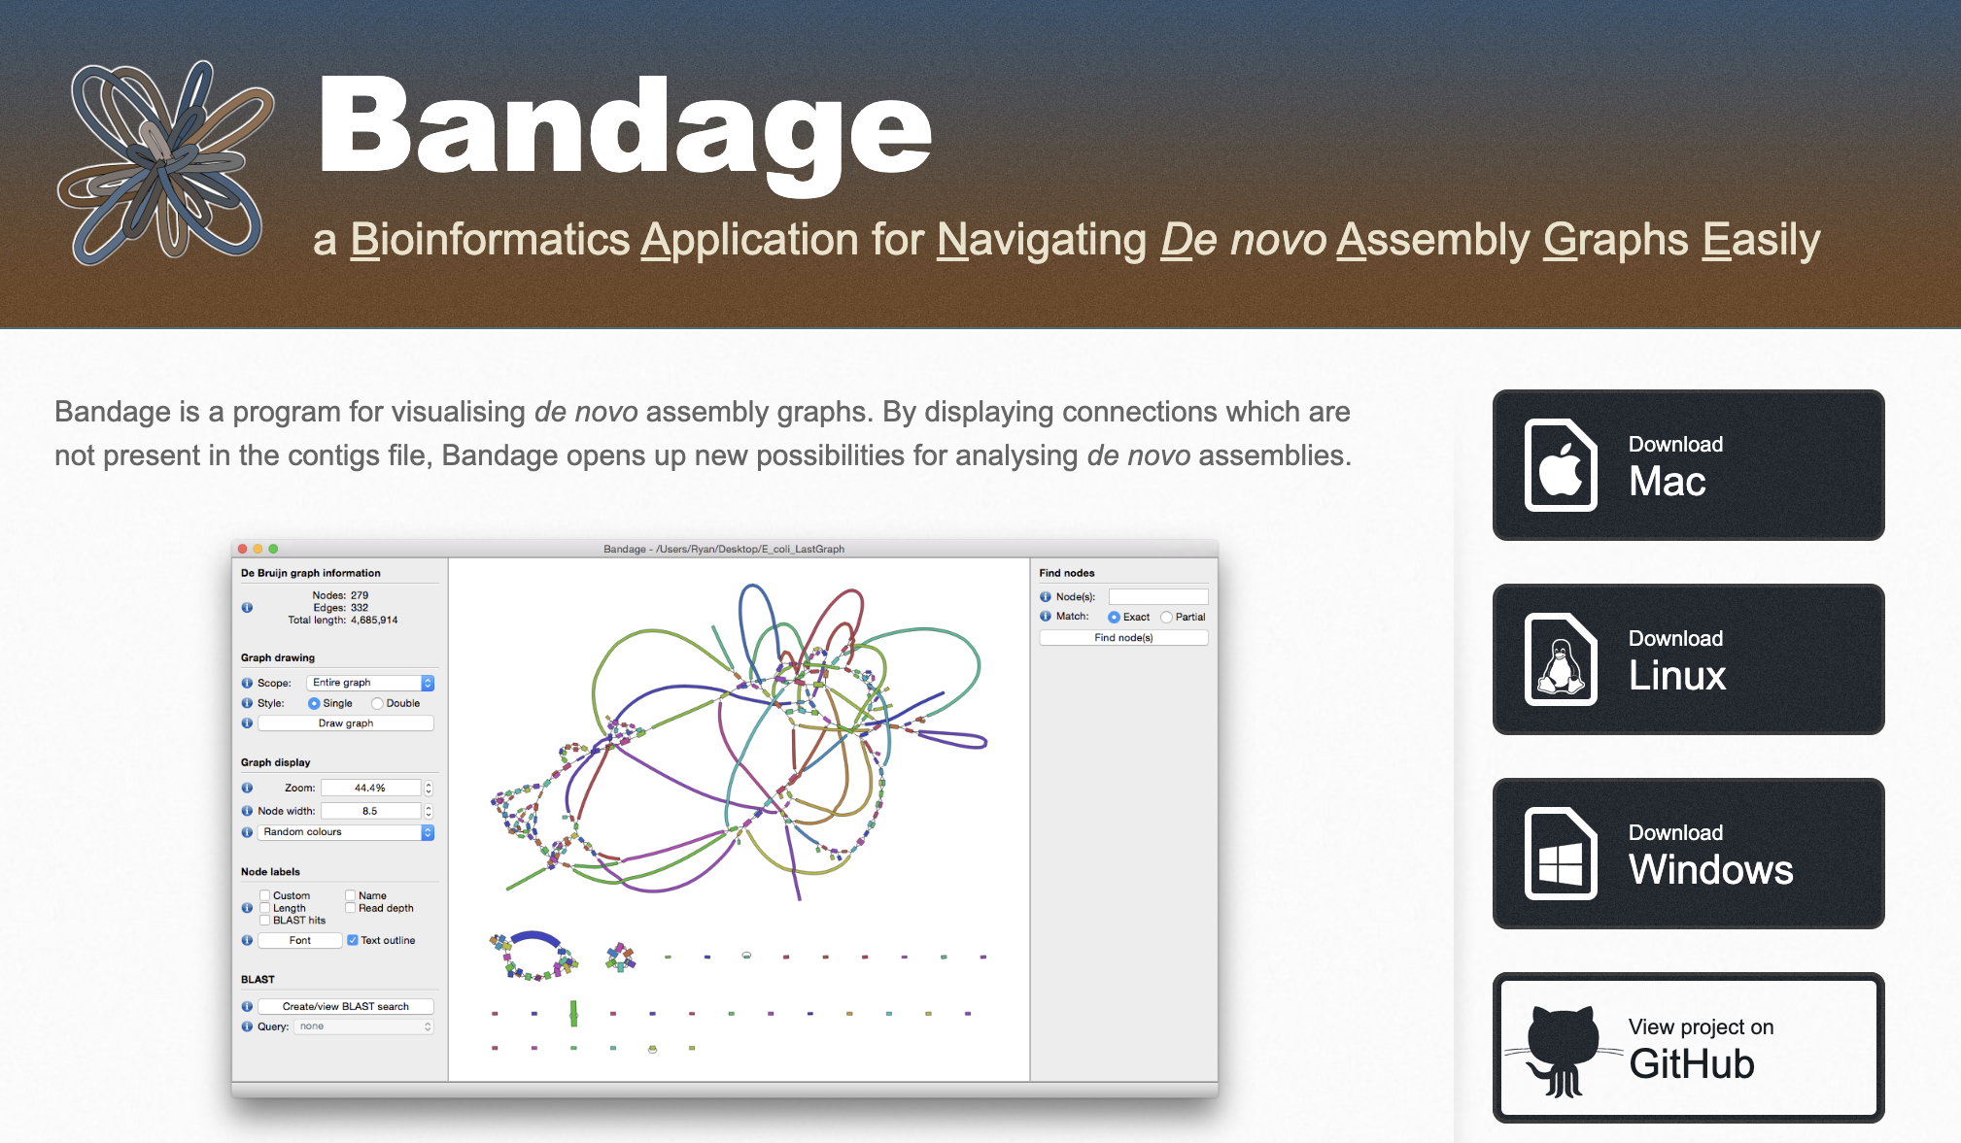
Visualising Assemblies
Screenshot from https://rrwick.github.io/Bandage/

Slide 35
Evaluating the Quality of Assemblies
How good is my assembly?
Metrics to evaluate assembly quality
No. of contigs: Total no. of contigs in the assembly
Largest contig: No. of bases in the largest contig
Total length: Total number of bases in all the contigs
N50: Length of the shortest contig at 50% of the total genome length

Slide 36
Calculating N50
N50: Length of the shortest contig at 50% of the total genome length
Arrange the contigs in the descending order of their lengths
Start adding up the lengths of all contigs from the beginning, until you hit 50% of the total length
60
70
100
30
50
40
50
100
70
60
50
50
40
30
100
70
60
50
50
40
30
200
400
N50 = 60
Adapted from https://www.molecularecologist.com/2017/03/29/whats-n50/

Slide 37
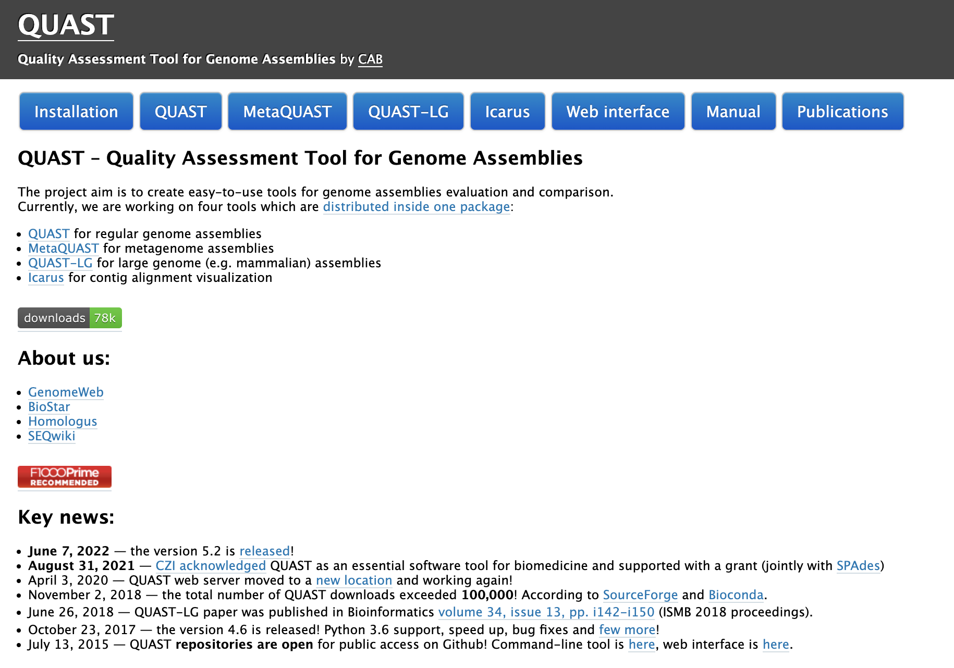
QUAST
Evaluates assemblies by computing various metrics
metaQUAST is the metagenomic version of QUAST
Screenshot from http://quast.sourceforge.net/

Slide 38
How to run QUAST?
Without reference genomes
metaquast.py -t 8 -o metaquast_out contigs.fasta
With reference genomes
metaquast.py -t 8 –r ref1.fasta,ref2.fasta,ref3.fasta -o metaquast_out contigs.fasta

Slide 39
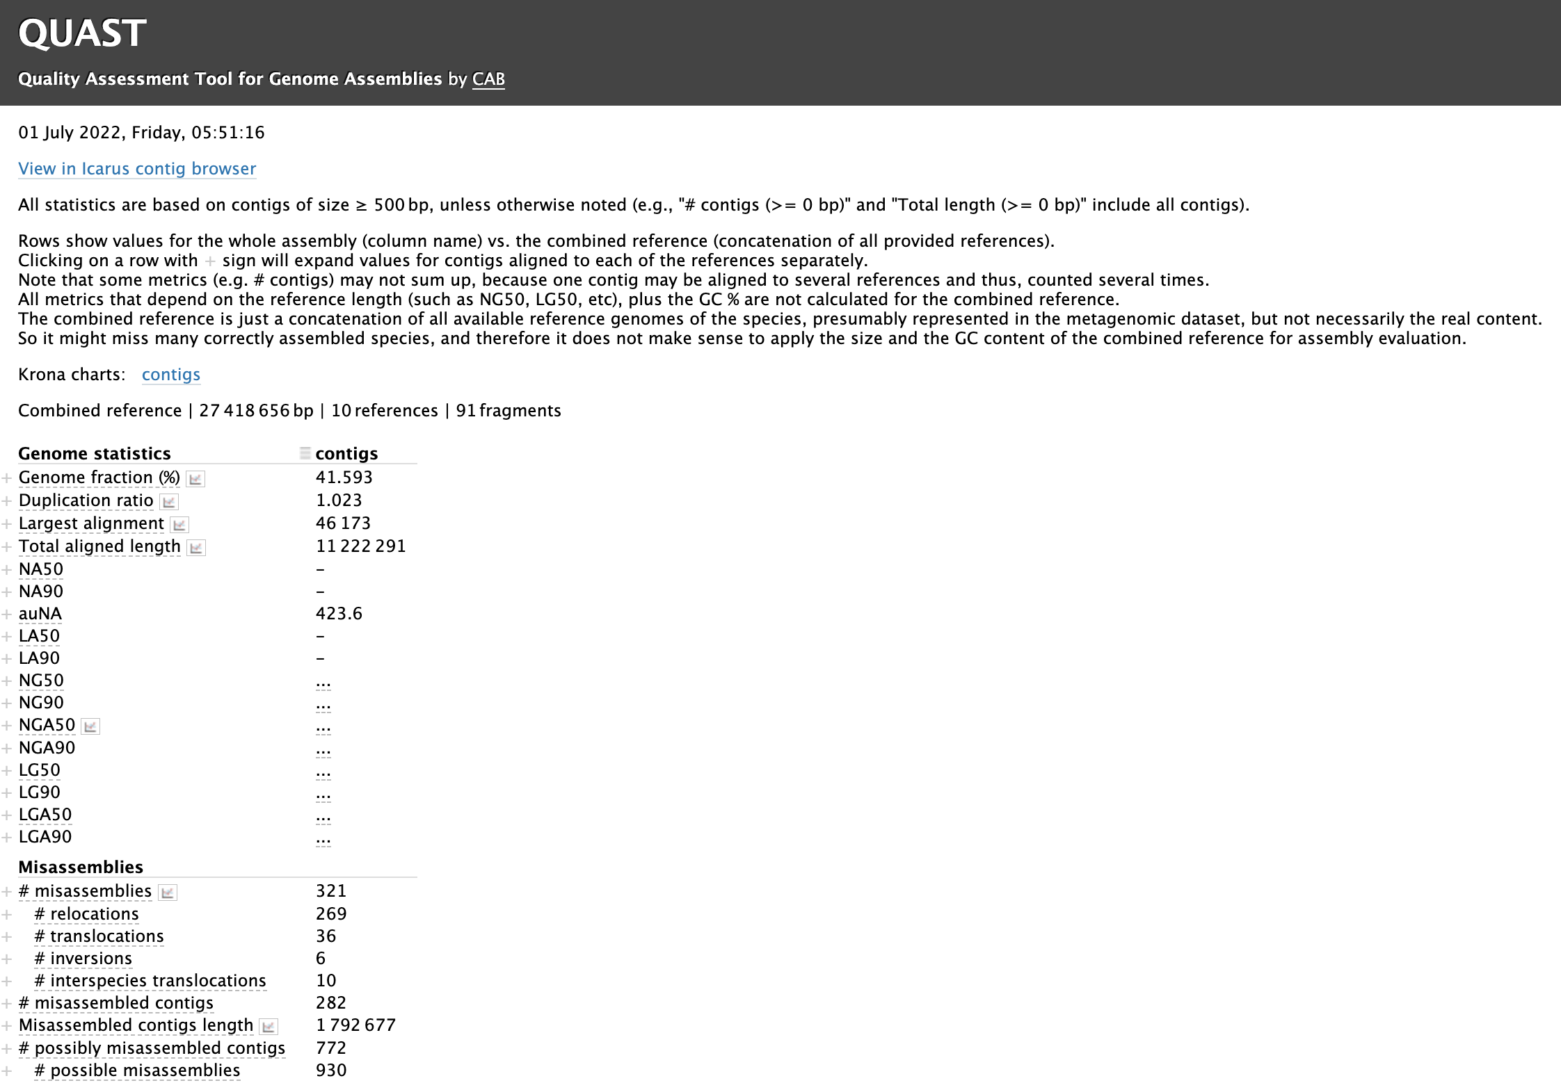
QUAST
metaQUAST results on the assembly of the wastewater samples

